Slide 1
kNN (K-Nearest Neighbours)
Sakthivel Mohankumar – 23040859 Machine Learning assignment
Algorithm which assumes that similar points are likely to have similar labels or values

Slide 2
Index
Introduction with Definition
Application of kNN algorithm
Introduction to Iris Dataset
Code to check the impact of 'k' value
Comparison
Conclusion

Slide 3
Definition
k-Nearest Neighbors (kNN) is a supervised machine learning algorithm used for both classification and regression tasks.
In classification, it predicts the class label of a data point based on the majority class of its nearest neighbors.
In regression, it predicts the value of a data point by averaging the values of its nearest neighbors.

Slide 4
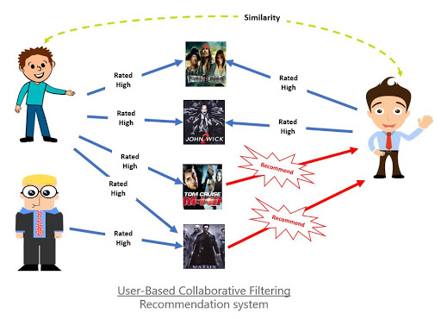
Application
kNN has practical uses in diverse fields due to its simplicity and effectiveness. Here are some real-world examples:
Recommendation Systems
Example: Movie or product recommendations.
How: Find users or items similar to the target user or product, then recommend items based on their preferences.

Slide 5

Application
kNN has practical uses in diverse fields due to its simplicity and effectiveness. Here are some real-world examples:
Fraud Detection
Example: Credit card fraud detection.
How: Compare new transactions with previous ones to classify them as legitimate or fraudulent based on similarity.

Slide 6
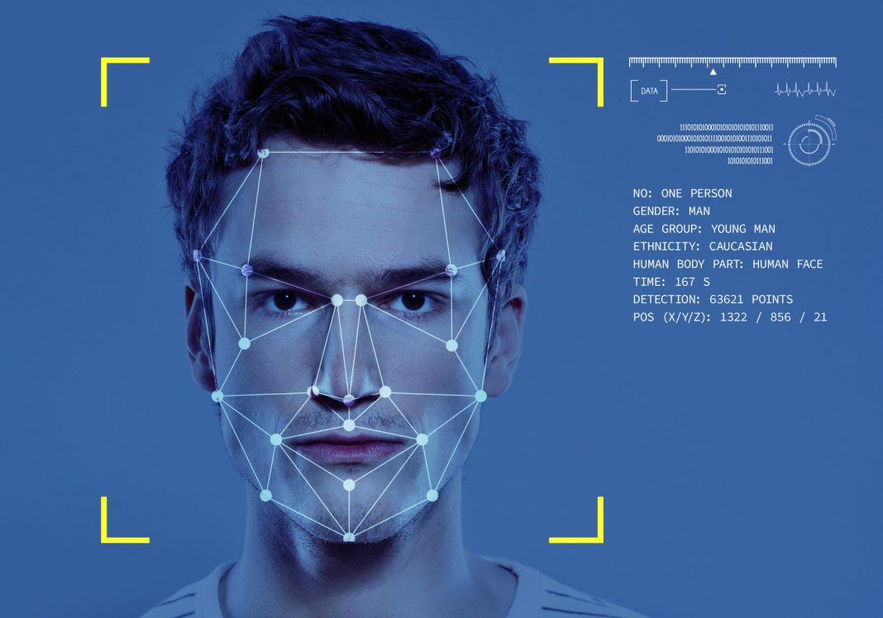
Application
kNN has practical uses in diverse fields due to its simplicity and effectiveness. Here are some real-world examples:
Image Recognition
Example: Handwriting recognition.
How: Identify the label of an image (e.g., digits in the MNIST dataset) by comparing it with the closest labeled images.

Slide 7

Application
kNN has practical uses in diverse fields due to its simplicity and effectiveness. Here are some real-world examples:
Medical Diagnosis
Example: Predicting diseases based on symptoms or medical images.
How: Match a patient's data with the nearest cases in the training set to predict the disease.

Slide 8
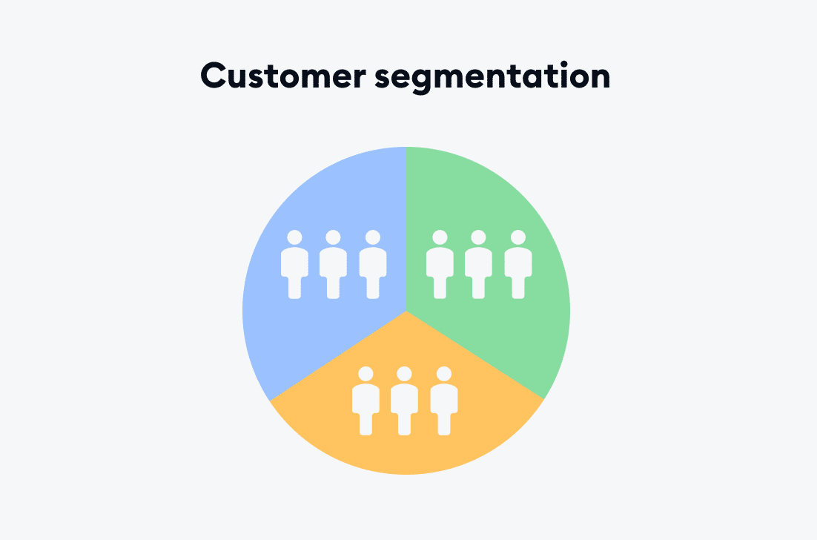
Application
kNN has practical uses in diverse fields due to its simplicity and effectiveness. Here are some real-world examples:
Customer Segmentation
Example: Grouping customers by purchasing behavior.
How: Classify new customers into clusters based on their similarity to existing groups.

Slide 9
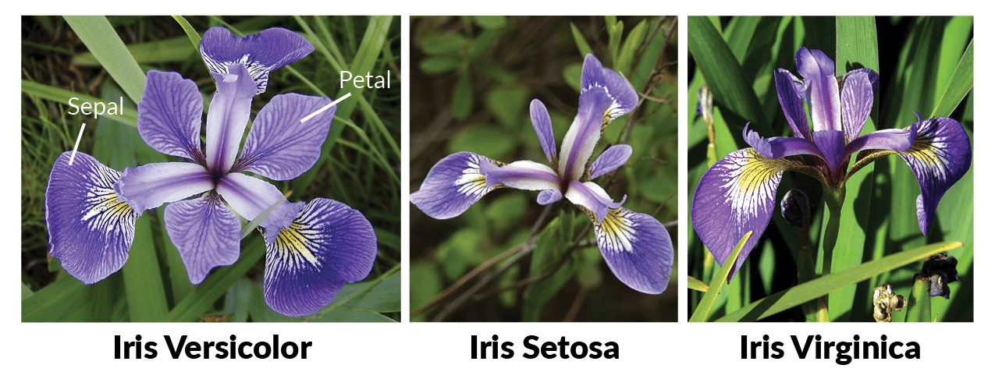
Introduction to the Iris Dataset

Slide 10
Introduction to the Iris Dataset
The Iris dataset contains: 150 samples of flowers belonging to 3 species:
Setosa, Versicolor, and Virginica.
We are going to consider 2 features for each sample:
Sepal length (cm)
Sepal width (cm)
The goal is to predict the species of a flower based on its features.

Slide 11
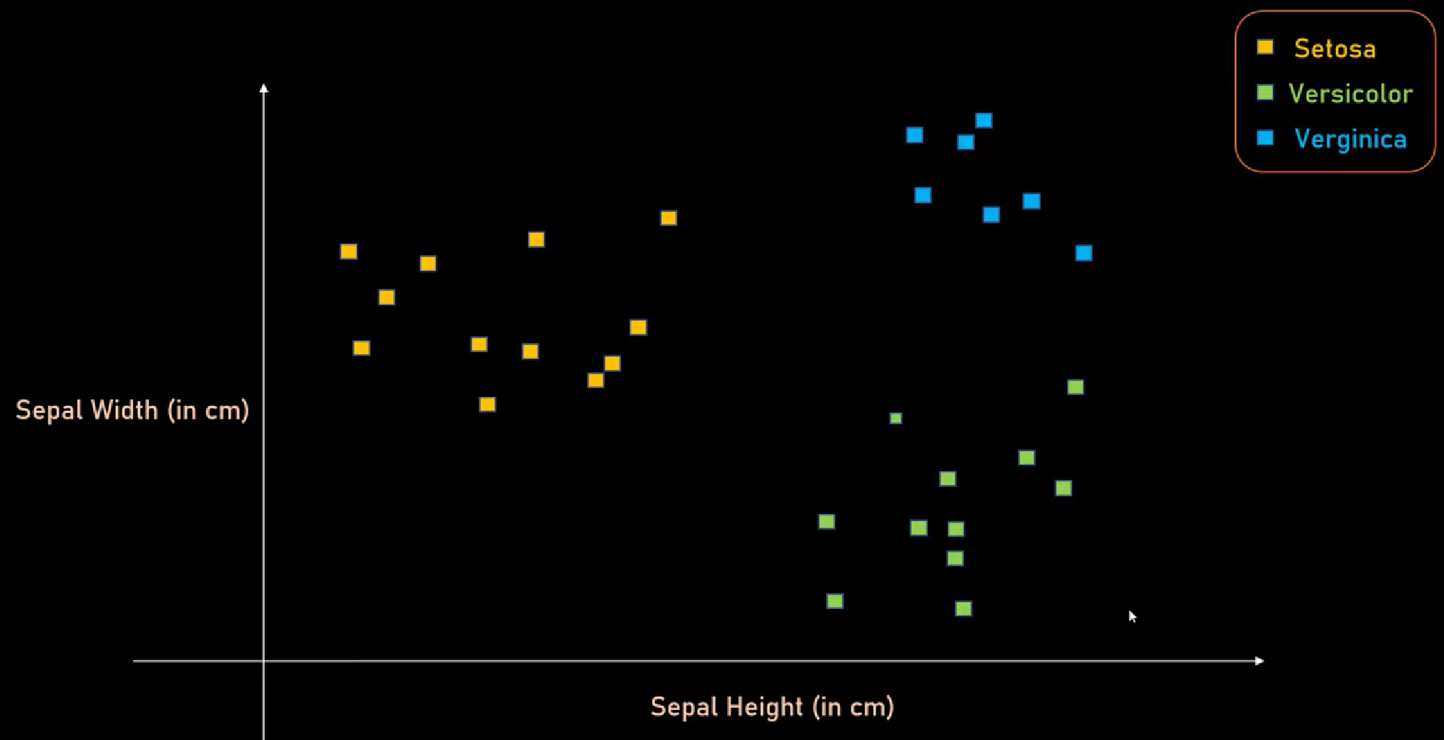
Data points plotted based on two features for Iris dataset

Slide 12
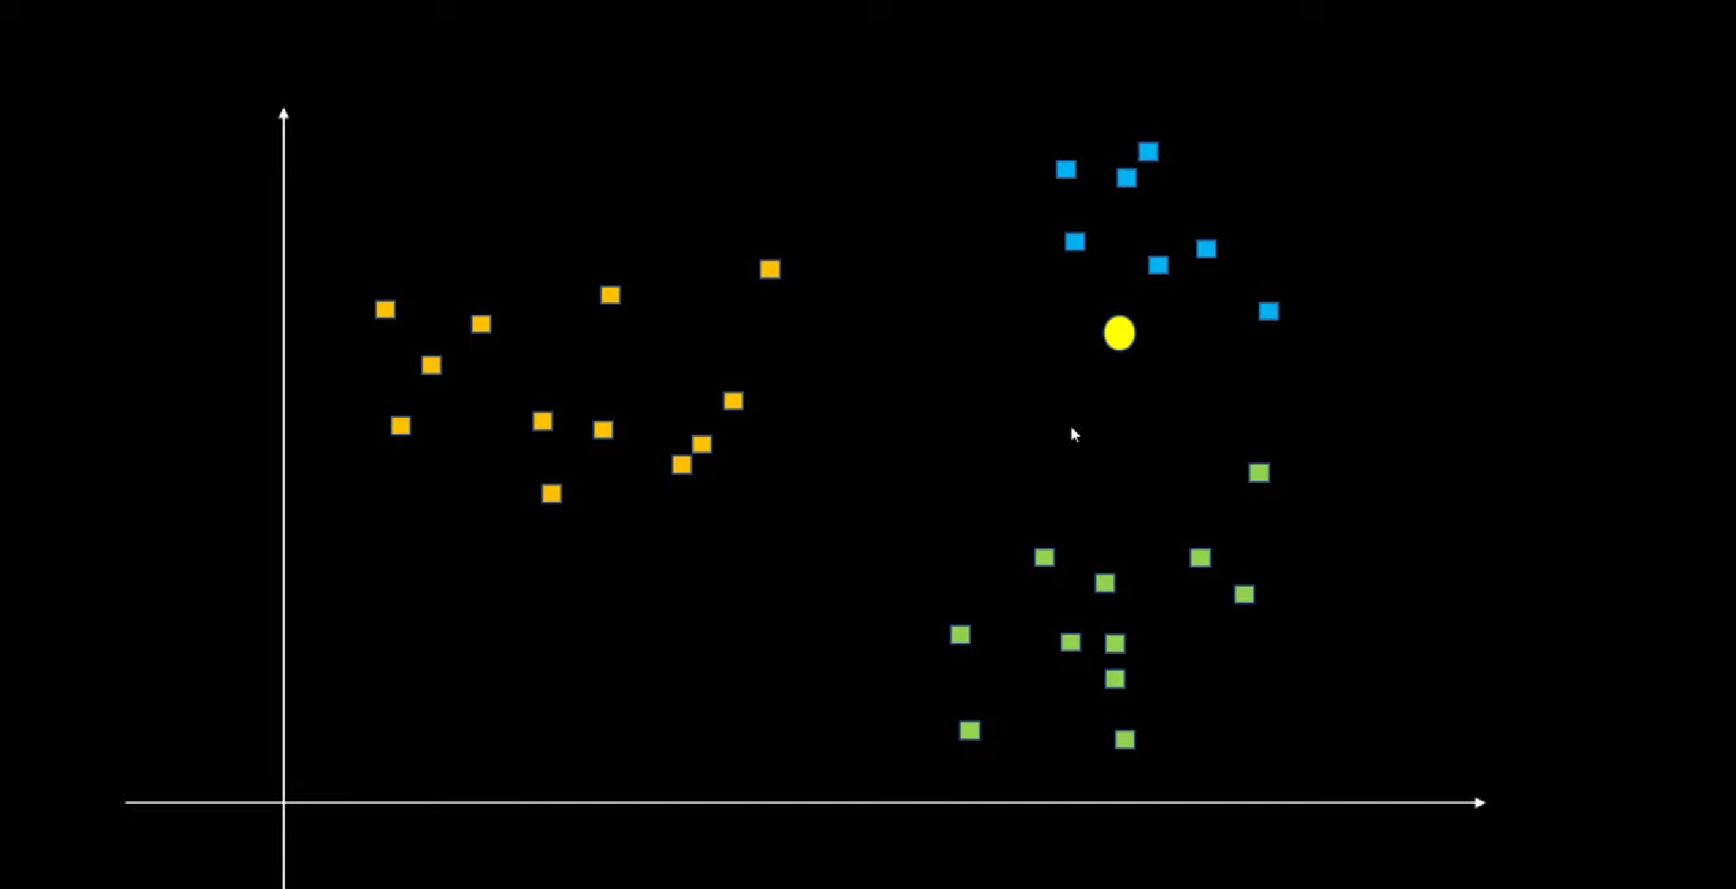
New datapoint highlighted with a yellow dot

Slide 13
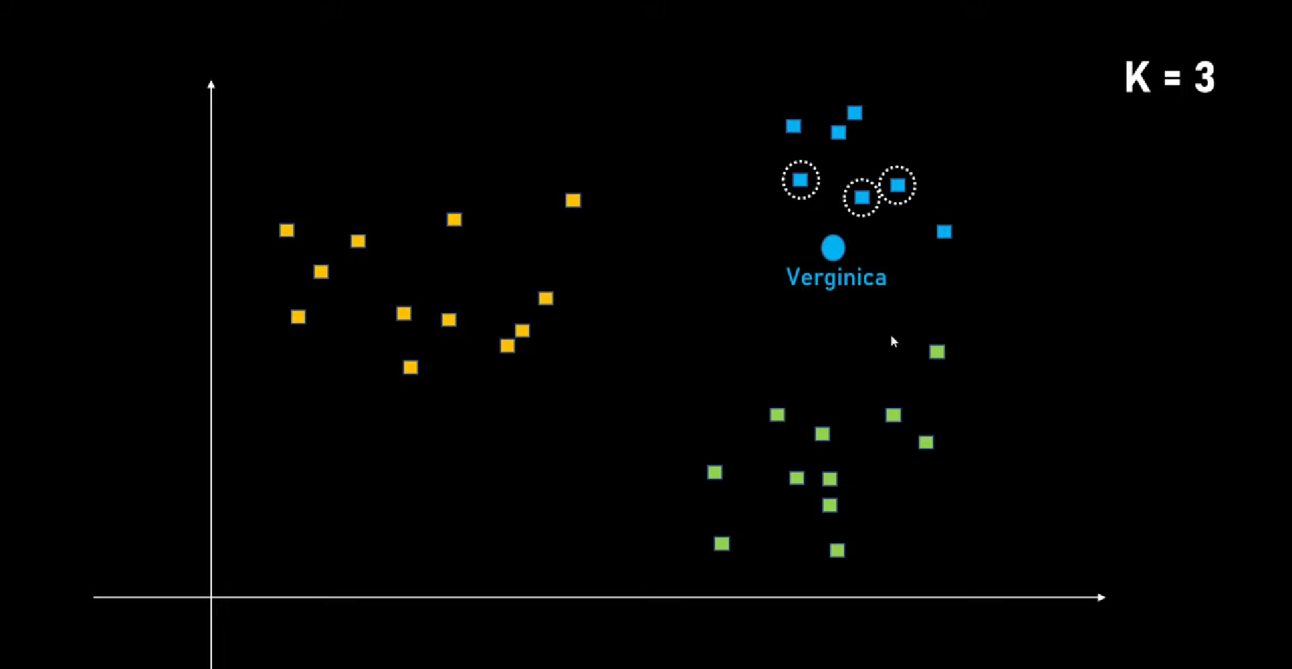
With k being 3, the nearest three data points are considered

Slide 14
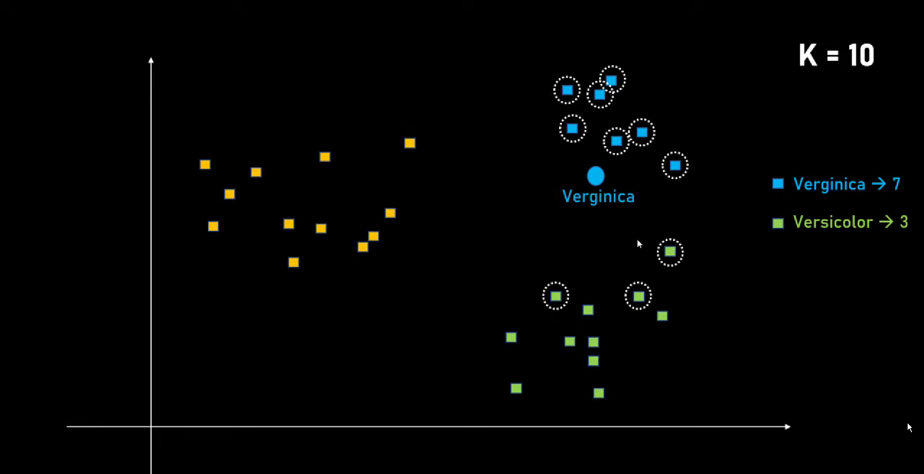
With k being 10 nearest ten neighbors are considered

Slide 15
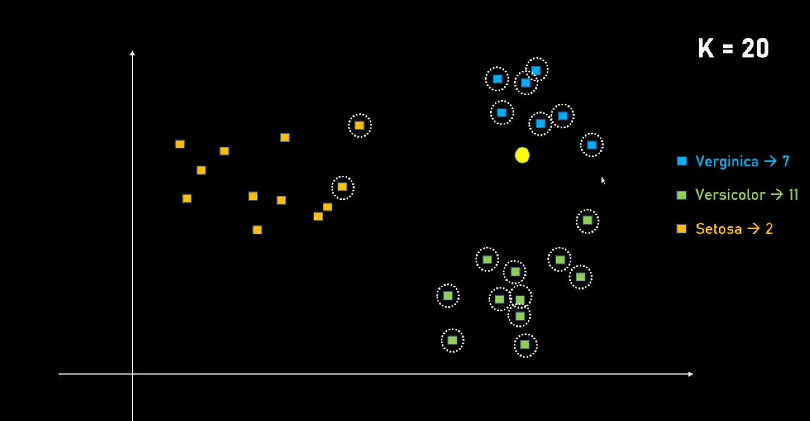
While k is considered to be 20, we get to consider more data points

Slide 16
Codes in Jupyter
Here is the link to my jupyter notebook where I have investigated the kNN algorithm with different 'k' value
MY JUPYTER CODE

Slide 17
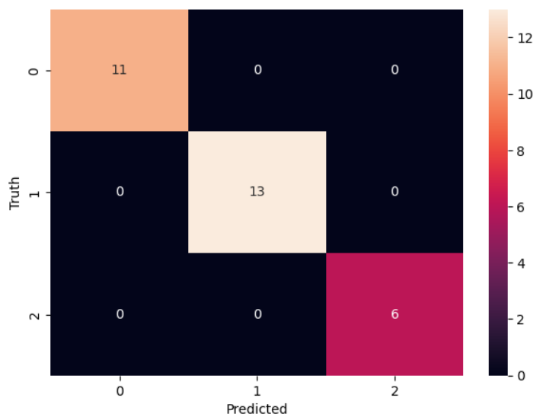
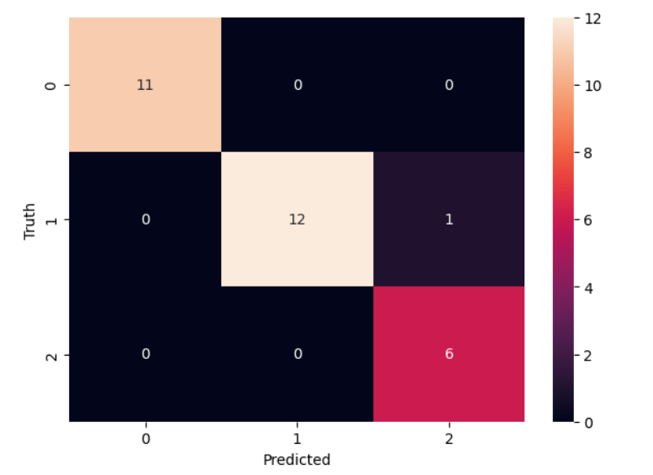
With k = 5 With k = 10

Slide 18
Conclusion
The k-Nearest Neighbors (kNN) algorithm is a simple yet effective machine learning method for classification and regression.
Using the Iris dataset, we demonstrated its ability to classify flower species with high accuracy. While kNN is easy to implement and interpret, it can be computationally intensive for large datasets and sensitive to the choice of k.
Despite these limitations, it is a reliable tool for smaller datasets, offering valuable insights with proper tuning and preprocessing.

Slide 19
Thank You

